Slide 1
PARSHVANATH CHARITABLE TRUST’S
A.P SHAH INSTITUTE OF TECHNOLOGY
Kasarvadavli, Ghodbunder Road,Thane-400615
Notes:
1
1

Slide 2
Courses
Sr No. | Name of Course(Branch) | Intake Capacity
1 | Computer | 60
2. | I.T, | 60
3. | EXTC | 60
4. | Mechanical | 120
5. | Civil | 120
A. P. SHAH INSTITUTE OF TECHNOLOGY, THANE

Slide 4
New initiatives of Institute
FE classes will be branch wise
Foreign languages is compulsory for FE, SE & it is included in time table.
We are starting mentoring programme from coming semester. One hour is reserved for mentoring in regular time table of all classes.
Two hours are reserved for SE student’s PBL Activity.
Term Test will be as per University question paper pattern & test will be 1.5 hr.
Faculties are expected to define topic & objectives of each lecture in Teaching Plan.

Slide 5
Lecture Duration & Lunch Breaks
1 Lecture : 55mins
FE(All), SE (CIVIL, MECH):12.40pm to 1:10pm
SE(COMP,IT,EXTC): 11.55am to 12.25pm
1 Lecture : 60mins
TE, BE (CIVIL,MECH): 1.00pm to 1.30pm
TE, BE(COMP, IT, EXTC): 12.10pm to 12.40pm

Slide 6
Tie-ups and Associations
Open Source Experimental Lab for Emerging Technologies in collaboration with Ashnik.
- Prof. Amol Kalugade, Prof. Anagha Aher.
RED HAT Academy Programme.
Coordinators: IT:Prof. Neha Deshmukh, Prof. Apeksha Mohite
COMP: Prof. Ramya R. , Prof. Sofiya Mujawar
Texas University Innovation Centre.
Coordinator : Prof. Selvin Furtado
E-Yantra lab in association with IIT Bombay.
Coordinator : Prof. Sonal Jain
IIT Bombay Spoken Tutorial.
Coordinator: Prof. Vishal Badgujar
GATE Coaching.
Coordinator: HODs
NPTEL local chapter.
Coordinator: Prof. Sachin Takmare
IIT Bombay Library Membership
Coordinator: Librarian
Innovation Centre of AI, Machine Learning, Data Analytics in collaboration with Beneath University.
CISCO Certification centre.
Coordinator : Prof. Jay Mehta
SKILL NEXT Programme in collaboration with BMW India.
Coordinator : Prof. Nikhil Khatekar

Slide 7
Proposed Tie-ups
TATA Nest Tie-up for Hostel Accommodation.
Earn & Learn Policy.
Biometric attendance for Staff and Reserve category students.
IELTS certification Training.
GRE/TOFEL Training.

Slide 8
Proposed NBA Activities
NBA Road map
By Rahul Ambekar
Date: 3rd July 2018, 2.00pm to 3.00pm
Rubrics, Project (Process and Policies), Mentoring Program
By Mugdha A., Rujata C., Brinal C.
Date: 4th July 18
Time for CIVIL,MECH: 10:00am to 12:00noon
Time for IT,COMP, EXTC, HAS: 2:00pm to 4:00pm

Slide 9
Special Weightages will be given in Appraisal for following things
Patents and Publications.
MooCS / NPTEL Certifications in their domain.
Professional Certifications.
Delivery and Attendance of STTP/ FDP.

Slide 10
Course /Academic Record File

Slide 11
Course File to be Maintained on Moodle Server and Hard Copy
Sr.No | Topics
1 | Institute Academic Calendar
2 | Departmental Academic Calendar
3 | Syllabus of the subject
4 | Individual Time Table
5 | Course Objectives
6 | Course Outcomes ( COs )
7 | CO-PO Matrix
8 | Curriculum Gap if any
9 | Action proposed to bridge the curriculum gap
10 | Teaching Plan
11 | University Question Papers
Sr. No | Topics
12 | Internal Assessment Plan
13 | UT papers and its Solutions
14 | Lab Manual
15 | Lab Plan
16 | Reference Books/ Material
17 | Innovative / Additional teaching techniques / tools to be used
18 | Result Analysis of Last 3 years of the said Subject
19 | Result Analysis of UTs.

Slide 12
Files to be maintained by all Departments
File Number | Name of the File | Type of File | Contents
1 | Vision, Mission & PEO | Normal | Vision. Mission. PEOs. Process for Formulation Dissemination.
2 | Program Outcomes | Box | POs . PSOs. Syllabus ( 2nd to 4th year). Curriculum Gap Identification ( Process).

Slide 13
File Number | Name of the File | Type of File | Contents
3 | Teaching Learning Process | Box | Academic Calendar (Inst & Dept) . Identification of Brighter & Weaker students . Evaluation & Assessment Process with scoring rubrics . Quality of Question Paper. Assignments with rubrics . Mini Project
4 | Student Project | Box | Project Process . Industry Interaction . Industry. Internship/Summer Training.

Slide 14
File Number | Name of the File | Type of File | Contents
5 | Course Outcomes | Box | Cos CO&PO Mapping CO&PSO Mapping Attainment of Course Outcomes ( Process) . Mapping with Set CO Attainment Targets .
6 | Student Record | Box | Student Record ( Admission). Enrolment Ratio . Success Ratio . Placement Details . Higher Education Details . Entrepreneurship . Professional Society Activity Student Achievements

Slide 15
File Number | Name of the File | Type of File | Contents
7 | Faculty | Box | Faculty Details . Student Faculty Ratio(SFR). Faculty Cadre Ratio . Faculty Retension. Teachinmg Innovation . FDP/STTP. Sponsored Research/Consultancy. Faculty Performance. Visiting/Adjunct Faculty.
8 | Lab Records | Box | Lab Info. Additional Facility. Project Lab. Lab Maintenance & Ambience.
9 | Audits | Box | Result Analysis ( Mapping with PO & PSOs). Academic Audit Improvement in Placements & Higher Education. Quality of Admitted Students.

Slide 16
File Number | Name of the File | Type of File | Contents
10 | Mentoring | Box | Mentoring Records .
11 | Feedbacks | Box | Feedback Analysis & Corrective Measures . Feedback on Facilities. Self Learning .
12 | Student Training Activities | Box | Carrier Guidance . Facilities Provided by Inst. EDC cell Co-curricular & Extra-Curricular Activities .

Slide 17
Academic Calendar Second Half 2018 (SE, TE & BE only) Academic Calendar

Slide 18
Sr.No. | Date | Day | Activity
1 | 06-07-2018 | Friday | Display of Time Table & submission of Teaching plan on Moodle
2 | 09-07-2018 | Monday | Commencement of Term
3 | 06-08-2018 | Monday | Founder’s Day
4 | 10-08-2018 | Friday | Display of Attendance & 1st defaulter list
5 | 15-08-2018 | Wednesday | Holiday - Independence Day Celebration
6 | 17-08-2018 | Friday | Holiday - Parsi New Year Day (Pateti)
7 | 22-08-2018 | Wednesday | Holiday- Bakri Eid
8 | 03-09-2018 | Monday | Holiday - Janmastami
9 | 08-09-2018 | Saturday | Working Day – Compensation for Diwali
10 | 10-09-2018 To 12-09-2018 | Monday To Wednesday | Term Test I & Academic Review - I
11 | 11-09-2018 | Tuesday | Display of Attendance & 2nd defaulter list
12 | 13-09-2018 | Thursday | Ganesh Chaturthi
13 | 13-09-2018 To 17-09-2018 | Thursday To Monday | Mid-term Vacation
14 | 21-09-2018 | Friday | Mohoram

Slide 19
Sr.No. | Date | Day | Activity
15 | 22-09-2018 | Saturday | Working Day – Compensation for Diwali
16 | 02-10-2018 | Tuesday | Mahatma Gandhi Jayanti
17 | 08-10-2018 To 10-10-2018 | Monday To Wednesday | Term Test II & Academic Review - II
18 | 12-10-2018 | Friday | Display of Attendance & 3rd defaulter list
19 | 15-10-2018 To 19-10-2018 | Monday To Friday | Submission for all subjects and Backlog term tests
20 | 17-10-2018 | Wednesday | End Semester Academic Review by Department
21 | 18-10-2018 | Thursday | Garba Celebration
22 | 19-10-2018 | Friday | Holiday- Dasera
23 | 22-10-2018 To 03-11-2018 | Monday To Saturday | Commencement of University Practical - Oral examination (Tentative)
24 | 05-11-2018 To 09-11-2018 | Monday to Friday | Diwali Vacation
25 | 20-11-2018 | Tuesday onwards | Commencement of University Theory Examination (Tentative)

Slide 20
Teaching Plan
Sr No. | Theory/Practical Topic Planned | Objectives | Planed Date | Actual Date of Coverage
1
2
3

Slide 21
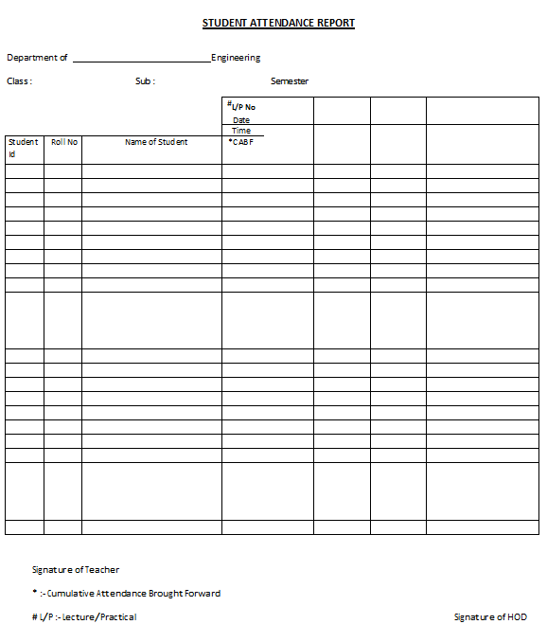
Student Attendance Report
Notes:
21

Slide 22
Report of Lecture/Practical Missed
Notes:
22

Slide 23
Class Advisors
Check List Smart Class
Inform students about college starting date
Inform about absent and late comers policy
Encouragement policy
Defaulter list dates
Test 1 & Test 2 dates
I-card Policy

Slide 24
Class Advisors
FE DIV A Mech | FE DIV B Mech | FE DIV C Civil | FE DIV D Civil | FE DIVE Comp & Extc | FE DIV F IT & Extc
S. B Shinde | N.I Shaikh | V R Nair | S.R.Yadav | A.S.Tambe | N R Chindarkar
SE COMP | SE IT | SE CIVIL | SE MECH | SE EXTC
Archana Kotangle | Rujata Chodhary | A –Priyaka A. Jadhav B –Mrunal Joshi | A-M A Jackson B-Rahul Singh | Tejashree Kolhe
TE COMP | TE IT | TE CIVIL | TE MECH | TE EXTC
Sofiya Mujawar | Anagha Aher | A-Vishal Misal B-Nitya K. | A- M G Gadale B-U M Momin | Sonia Aneesh
BE COMP | BE IT | BE CIVIL | BE MECH | BE EXTC
Brinal Colaco | Neha Deshmukh | Raksha Khandare | Abhilash Nair | Veena Gawade

Slide 25
Policy for Improvement in Attendance
Collect undertaking, during admission, from the parent whose wards attendance very poor in the previous semester.
( list of those students must be prepared by previous class advisor & must be submitted to the class advisor of present semester of the student).The presence of at least one of the parents of those students is compulsory during admission.
‘Very strict’ action should be taken against students having very poor attendance in this semester & this should be monitored by the HODs
Notes:
25

Slide 26
Undertaking by Students & Parent

Slide 27
Late Comer and Absent Policy

Slide 28
Good Practices
Be well prepared for every lecture.
Get standard results before conduction of practicals.
Give presentations to HoD and senior faculty on all Expt.
Every semester add at least two new expts.
Check journals/assignments regularly
Switch off fans tubes /save electricity
Begin your day with plan
Join Subject expert groups.

Slide 29
Subject Expert Group
Objectives
Improvement in the subject knowledge
Formation of a setup of Lab sessions in the subject
Identification of latest trends in the subject domain
Project counseling to the Third and Final year students.
Seminars on special topics by Industrial experts in that domain.
Identification Interdisciplinary projects.
Promotion of various research initiatives taken up by staff.

Slide 30
Software utilities available at APSIT
Existing:
Moodle E-learning Software
Webstore
Payment Portal
Library Management Software
Central Repository Server : FTP
New:
Student Diary &Makeup course registration
Web Conferencing Facility

Slide 31
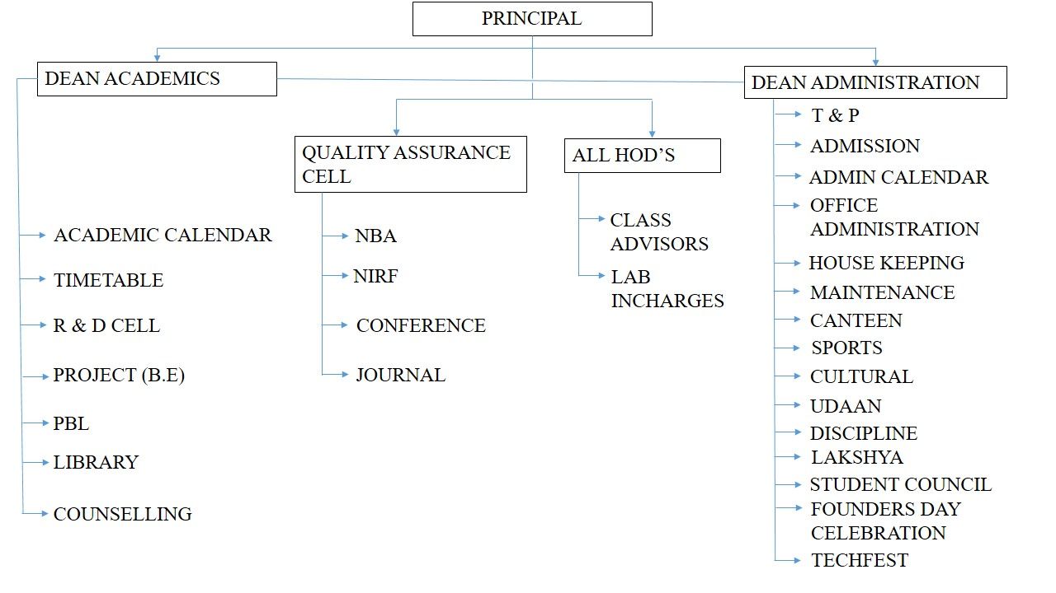
Organization Chart

Slide 32
Academic Activities at APSIT
Since FE classes would begin late, the academic calendar of FE and higher classes would be different.
Tentative academic calendar Higher classes (SE,TE,BE) academic calendar is circulated. Faculty can prepare course plan and objective of each lecture according to that calendar.
Academic calendar has details of academic schedule, test schedule, diwali vacation, holidays and various celebrations within college.

Slide 33
Cont…
Faculty is required to update lecture notes, ppt's and other course material on Moodle server so that students can access the material uploaded.
Moodle activities of the faculty will be monitored by concerned HODs

Slide 34
IT Infra & Maintenance

Slide 35
MOODLE: E-LEARNING PLATFORM
HOD’S must update subjects and respective faculty names for Moodle enrolment by using google sheet shared on email after subject distribution.
Faculties must update their course pages as per guidelines given. Documentation of same is given to faculties at the time of joining.
HOD’s must ensure that all faculties course pages are updated as per guidelines.

Slide 36
MOODLE: E-LEARNING PLATFORM cont…
HOD’s must fill-up the report of Moodle Updation as per schedule by using Google sheet shared on their mail.
HOD’s will get gentle reminder of same through SMS.
In case of any query Contact Moodle Team

Slide 37
Procedure for IT Maintenance
Faculties must contact Department Coordinator in case of any problem related to IT Resources.
Department Coordinators shall initiate compliant by using Google Sheet shared on their Mail.
Web Links related to IT Enabled services are available on Moodle Server

Slide 38
Training Session Schedule
Moodle, WebStore: 05 July 2018 at 3 pm (Room no317)…………Prof. Neha Deshmukh, Prof.Anagha Aher
Interactive Class :05July 2018 at 4 pm(Room No 317)…………Prof. Amol Kalugade, Prof. Apeksha Mohite

Slide 39
Suggestions
Faculties need to follow Institute rules strictly. Their decisions shall not be biased based on their past their past experience.
Faculties are most invited for suggestions directly or indirectly for improvement in Academics
Send your suggestion on Principal Mail ID
The college expects more participation in coming semester

Slide 40
Mechanism to avoid proxy attendance
Attendance Callout in beginning of Lect.
Mark absent no. by X
Circulate attendance to student for sign

Slide 41
Format for suggestions
Suggestion
Advantages
Limitations
Implementation and Monitoring Mechanism

Slide 42
Thank You !

Slide 43
WELCOME
TO
NEW ACADEMIC
YEAR
2018-19

Slide 44
Introduction of Newly Joined Faculty
Name
Department Joined
Experience

