Slide 2
Welcome
to
Department of --------------------------
HOD PHOTO
Name & Qualification
DEPT. LOGO

Slide 3
Index
Vision and Mission
Goals
Department
Teaching and Learning
Faculty
Student
Curriculum
Activities
DEPT. LOGO

Slide 4
Short Term Goals
DEPT. LOGO

Slide 5
Long Term Goals
DEPT. LOGO

Slide 6
Department
DEPT. LOGO

Slide 7
Year of Establishment and Intake
Programme | Intake
Name of Dept | Started with ____intake in ____
 | Increased to ___ in _______
AICTE APPROVAL
DEPT. LOGO

Slide 8
Admissions Intake
Items | CAY 2011-12 | CAY m1 2010-11 | CAY m2 2009-10 | CAYm3 2008-09
Sanctioned Intake Strength in the program
No. of total admitted students in First year
No. of total admitted students (including lateral entries in 2nd year, if any), belonging to the same batch | Lateral entries to this batch will come in 2012-13.
DEPT. LOGO

Slide 9
Student Strength
Class | Boys | Girls | Total
SE
TE
BE
Total
DEPT. LOGO

Slide 10
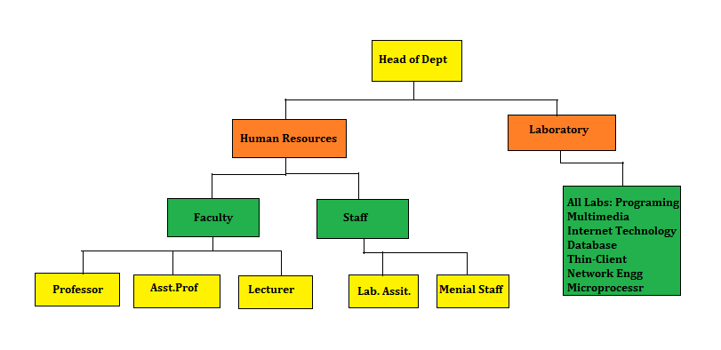
Organization of Department
DEPT. LOGO

Slide 11
Infrastructure
Name | Number | Area (sq.m)
Class Rooms | 02 | 174.26
Laboratories | 07(02 Shared) | 606.63
Seminar Hall | 01 | 87.13
Tutorial Hall | 01 | 58.08
Department Library | 01 | 58.08
HOD Cabin | 01 | 29.04
Faculty rooms | 10 | 151.2
Faculty room for T&P officer | 01 | 10.8
DEPT. LOGO

Slide 12
Laboratories
Lab. Name | Area(Sq.m) | Cost of Equipments in (Rs)
DEPT. LOGO

Slide 13
Computational Facilities
Computers
83 Nos. with Core i3/Core-2-Duo/Dual Core .
5 Nos. Laptops of DELL Brands.
25 Nos. Thin clients & one IBM Server.
Hardware
Client-Server with CAT6 cabling
15 ESA Microprocessor kits
Total 48.2 KVA built in battery
LCD-2nos & 4 Printers
DEPT. LOGO

Slide 14
New Facilities Created
Enrichment of study Material
IEEE society membership
E-learning Resources- MITOCW,NPTELIIT,IUCEE
E-learning Resources- Digital Library
Thin client Technology
Modern teaching aids
Preparation for higher studies and job opportunities.
Online Student Feedback Systems
Mentoring small students’ group
DEPT. LOGO

Slide 15
Teaching & Learning
DEPT. LOGO

Slide 16
Best Practices
Subject allotment on last day of previous semester
Workplan ready on commencement of semester
Academic calendar, Activity calendar published
Allotment of departmental activities
Industrial visit
Continuous assessment
Remedial classes, Makepup classes, Three test per semester,feedback,tutorial ,mentoring etc
DEPT. LOGO

Slide 17
Remedial & Makeup Classes
Remedial classes conducted for unsuccessful students in previous examination.
Makeup classes taken for weaker students and late admitted students (DSE) at SE level.
DEPT. LOGO

Slide 18
Mentoring System
One mentor for small group of students.
Mentors conduct regular meetings.
Student presents problems before mentors.
Mentor analyses the problems and discusses with class coordinators, HOD & Principal and finds solutions.
Counseling is given to the students.
DEPT. LOGO

Slide 19
Continuous Evaluation
3 Tests are conducted per semester
Practical Assignments are evaluated regularly
Internal marks are given on the basis of
- 3 Tests
- Attendance
- Assignments completed in time
- Vivas
DEPT. LOGO

Slide 20
Students’ Feedback
Online students’ feedback & well documented feedback.
Twice in a semester.
Feedback analyzed and metrics calculated.
Feedback communicated to faculty.
Faculty takes improvement steps for content delivery.
Improvement is monitored.
HOD discusses with class.
DEPT. LOGO

Slide 21
Feedback From Stakeholders
Alumni
Feedback during their visit to institute and alumni meet.
Feedback is received through website, emails & hard copy.
Use – For curriculum updation and improving PEOs.
Parents
Feedback during every vacation .
During parents meet.
Use – For improving facilities and guiding wards for the future.
Industry
Faculty visits industry and seeks its feedback.
Industries visiting institute for placement and gives feedback.
Use – For improving PEOs & specifying requirements of
industry for curriculum update.
DEPT. LOGO

Slide 22
Faculty
DEPT. LOGO

Slide 23
List of Faculty
Sr. No | Name of Faculty and Designation |  | Qualification | Areas of Specialization | Date of joining | Experience (Years)
1 | PHOTO
2
3
4
5
DEPT. LOGO

Slide 24
Supporting Staff List
Sr. No | Name of the Tech Staff | Date of Joining | Exclusive or shared | Qualification
1
2
3
4
5
6
DEPT. LOGO

Slide 25
Menial Staff List
Sr. No | Name of the Tech Staff | Date of Joining | Exclusive or shared
1
2
3
4
DEPT. LOGO

Slide 26
Teacher Student Ratio
Year | SE | TE | BE | Total | No.Faculty | TSR
CAY m2(2009-10) | 73 | 69 | 76 | 218 | 14 | 15.57
CAY m1 (2010-11) | 72 | 66 | 70 | 208 | 13 | 15.85
CAY (2011-12) | 73 | 77 | 64 | 214 | 14 | 15.28
DEPT. LOGO

Slide 27
Cadre Ratio
Year | Professors | Assistant Professor | Total Faculty | CRI
CAY m2 (2009-10) | 1 | 2 | 14 | 0.64
CAY m1 (2010-11) | 1 | 1 | 13 | 0.52
CAY (2011-12) | 2 | 0 | 14 | 0.32
DEPT. LOGO

Slide 28
Faculty Retention
Faculty retain due to
Regular monthly salary
Promotions for eligible candidates
DA with difference as per government
rules
Freedom with responsibility
Healthy environment
DEPT. LOGO

Slide 29
Grants Received
Year 2009-10
AICTE Sponsored SDP on Persona for Effective teaching.
Year 2010-11
AICTE Sponsored SDP on Persona for Effective Teaching.
Year 2011-12
Project grant for R&D project by IEI India for project guided.
DEPT. LOGO

Slide 30
Consultancy
Year 2010-11
7 faculty consulting Private sector, Sponsoring trust/Society for software development and networking tasks.
Year 2009-10
7 faculty consulting Private sector, Sponsoring trust/Society for software development and networking tasks.
Year 2008-09
7 faculty consulting Private sector, Sponsoring trust/Society for software development and networking tasks.
DEPT. LOGO

Slide 31
Interaction of Faculty with Outside World
DEPT. LOGO

Slide 32
Faculty Portfolio
Sr. No | Year | Papers Published | Journal | Conference
 |  |  | International | International | National
1 | 2008-09
2 | 2009-10
3 | 2010-11
4 | 2011-12
Total
DEPT. LOGO

Slide 33
Books Published/Reviewed
DEPT. LOGO

Slide 34
Skill Upgradation Programmes
Rational Rose UML & ROBOT
IBM DB2
AICTE sponsored SDP’s on Persona for Effective Teaching
Training on DBMS(IIT B)
Training on Firewall(Sonicwall)
Workshop on Research Methodology(0rchid Engg)
Training on Thin Client Technology
Training on PHP
Theoretical Computer Science(IUCEE)
ASP.NET from Microsoft IT academy
DEPT. LOGO

Slide 35
Training Conducted by Faculty
Sr. No. | Name of Professional Bodies | No. of Members
01 | IEEE | 01
02 | ISTE | 02
03 | IE(I) | 08
DEPT. LOGO

Slide 36
Student
DEPT. LOGO

Slide 37
Admission Quality
Rank Range % | CAY 2011-12 | CAYm1 2010-11 | CAYm2 2009-10 | CAYm3 2008-09
1 to 10,000 | 00 | 00 | 08 | 26
10,001 to 20,000 | 04 | 03 | 15 | 24
20,001 to 50,000 | 15 | 21 | 20 | 09
50,001 to 1,00,000 | 14 | 20 | 15 | 00
Above 1,00,001 | 00 | 15 | 02 | 00
DEPT. LOGO

Slide 38
Academic Performance
DEPT. LOGO

Slide 39
Placement & Higher Studies
DEPT. LOGO

Slide 40
Students Awards
Best Class award
Best student of institution award in
Highest blood donating class 2009-10
DEPT. LOGO

Slide 41
Students’ Achievements
Paper Presentations
Project Competition
Programming Contests
Robotics
Youth Festival
Sports Activities
DEPT. LOGO

Slide 42
Awards In Co curricular & Extracurricular activities
Items | Year
 | 2011-12 till date | 2010-11 | 2009-10 | 2008-09
No. of Award winner students | 04 | 28 | 03 | 10
First Award Winners | 02 | 09 | 02 | 03
Second Award Winners | 03 | 13 | 01 | 01
Consolation Award Winners | -- | 06 | -- | 03
Finalist | -- | -- | -- | 03
DEPT. LOGO

Slide 43
Student Forum
Student chapter of ISTE
CISA(Computer and Information Technology Student’s association)
NSS(National Social Service)
Soft Skill Development cell
Entrepreneurship Development (ED) Cell
Elocution and Debate Cell
Technical Magazine, Newsletter
DEPT. LOGO

Slide 44
Alumni
Alumni Association at Institute Level.
Every Year alumni meet is organized.
Alumni visits institute frequently & contribute for curriculum.
Alumni are working in MNC’s at top level.
Alumni have taken higher education from universities abroad & within the country.
DEPT. LOGO

Slide 45
Distinguished Alumni
Name , Post, organization
DEPT. LOGO

Slide 46
Programme Educational Objectives
To prepare students for successful careers in industry and make them compatible IT professionals to meet the needs of Indian and multinational companies.
2) To develop the ability among students to gain knowledge about core and Application domain subjects in IT, use them to analyze & design real world problems.
3) To provide opportunity for students to work as part of teams on various projects which are multidisciplinary in nature requiring logical and programming skills.
DEPT. LOGO

Slide 47
Programme Educational Objectives
4)To provide students with a sound foundation in mathematics, science & technology , necessary to analyze & solve real world problems and to prepare them for Graduate studies and research.
5)To promote student awareness for life-long learning and to introduce them to professional ethics.
6) To improve communication & presentation skills.
7) To introduce students with latest technologies.
8) To make students aware on general issues and build a good social personality.
DEPT. LOGO

Slide 48
Programme Outcomes
a.Graduates will use principles and methodologies of basic sciences, mathematics and basic engineering disciplines to solve technical problems.
b.Graduates will use methodologies and tools of software engineering and core to demonstrate an ability to analyze, formulate, design and develop real world problems.
c. Graduates exhibit research and problem solving skills to support lifelong personal and professional development.
DEPT. LOGO

Slide 49
Programme Outcomes
h. Graduates will be motivated towards successful career in industry and have good placement.
i.Graduates will show an aptitude as desired by Indian and multinational companies.
j. Graduates go for higher studies.
DEPT. LOGO

Slide 50
Curriculum updates & PEO reviews
Class | First Implementation | First Revision | Second Revision | Third Revision
F.E. | 1996-97 | 2002-03 | 2007-08
S.E. | 2000-01 | 2001-02 | 2003-04 | 2008-09
T.E. | 2001-02 | 2004-05 | 2009-10
B.E. | 2002-03 | 2005-06 | 2010-11
PEOs are reviewed as per the requirement of industry, curriculum update and stakeholders feedback.
DEPT. LOGO

Slide 51
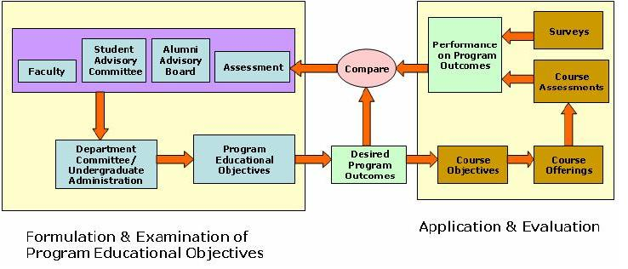
Various Committees for PEO review
DEPT. LOGO

Slide 52
Contents at a glance for Theory module
 | Basic Sciences | HSS | Professional Core | Elective | Breadth | Total
AICTENorms | 15 – 25 % | 5-10% | 55 – 65% | 10-15% | 10-15% | 95 – 130 %
Actual | 15.68% | 5.8% | 55% | 11.78% | 13.72% | 100 % +1.98%
DEPT. LOGO

Slide 53
Emphasis on laboratory and project
 | Theory (Teaching) | Tutorials | Practical | Project (Final Year) | Total
AICTE Norms | 60% max. | Above 10% | Above 25% | 30-40%
Actual | 64% | 8% | 33% | 23% +10% | 100% +
Comment | High | Low | OK | Ok
DEPT. LOGO

Slide 54
Beyond Syllabi Contents
Training on design & application S/W
Mini Projects
Quiz competitions.
E-learning
Workshops
Expert lecture & talks
Real world case studies
Aptitude test for increasing competitive skill
Demonstrations, exposure to practical environment
Encouragement for Entrepreneurship
DEPT. LOGO

Slide 55
Activities
DEPT. LOGO

Slide 56
Activities Conducted
WITech – A National Level Poster Competition, Quiz Competition, Technical Innovations
Training and Certification by Microsoft IT Academy and LogiTech, Pune.
Seminars, Workshops
Competitions
Industrial Visits
Publication of Technical Magazines, News letters
Social Programs
DEPT. LOGO

Slide 57
Weaknesses of Department
Less participation of students in competitive exams.
Departmental library needs to be strengthened
Research and Consultancy needs to be increased
DEPT. LOGO

Slide 58
Thank You
DEPT. LOGO

